Slide 1
PREDICTIVE ANALYTICS
Gaining Insight into the Student Dataset
TechTalent South - ACDC Project
Instructor: Travis Ahalt
Members: Kofi Kyei, George Tryfiates, Emmanuel Dadzie

Slide 2
OUTLINE OF PRESENTATION
INTRODUCTION
EXPLORATORY DATA ANALYSIS
HYPOTHESIS TESTING / INFERENTIAL STATISTICS
MACHINE LEARNING PREDICTIVE MODELING
CONCLUSION

Slide 3
INTRODUCTION
1
Data acquisition, Objectives, and Scope

Slide 4
DATA ACQUISITION
The dataset for the project was acquired from UCI repository
The student performance dataset was selected for this analytics project
This dataset has 1044 instances and 34 attributes
This dataset has both numeric and categorical variables

Slide 5
PROJECT OBJECTIVES
This project is aimed at exploring the student performance dataset to gain useful insights that could be used to make decisions on the controlling factors
A predictive model built from machine learning (ML) algorithms will facilitate the prediction of grades or other factors depending on other contributing .

Slide 6
PROJECT SCOPE
Conduct exploratory analysis on the data to derive basic information about the data
Perform preprocessing to deal with missing values and outliers
Create visualizations to communicate some of the descriptive information about the data
Perform inferential statistics to establish relationships between the dependent and independent variables
Create a predictive model using ML algorithms

Slide 7
EXPLORATORY DATA ANALYSIS
2
Exploration, Cleaning, Preprocessing, and Visualization

Slide 8
DATA EXPLORATION
*** Full Student Datasets
school course sex age address ... health absences G1 G2 G3
0 GP Math F 18 U ... 3 6 5 6 6
1 GP Math F 17 U ... 3 4 5 5 6
2 GP Math F 15 U ... 3 10 7 8 10
3 GP Math F 15 U ... 5 2 15 14 15
4 GP Math F 16 U ... 5 4 6 10 10
.. ... ... .. ... ... ... ... ... .. .. ..
644 MS Portuguese F 19 R ... 5 4 10 11 10
645 MS Portuguese F 18 U ... 1 4 15 15 16
646 MS Portuguese F 18 U ... 5 6 11 12 9
647 MS Portuguese M 17 U ... 2 6 10 10 10
648 MS Portuguese M 18 R ... 5 4 10 11 11
[1044 rows x 34 columns]
*** Clean Data
school course sex age address ... health absences G1 G2 G3
1 GP Math F 17 U ... 3 4 5 5 6
2 GP Math F 15 U ... 3 10 7 8 10
3 GP Math F 15 U ... 5 2 15 14 15
4 GP Math F 16 U ... 5 4 6 10 10
5 GP Math M 16 U ... 5 10 15 15 15
.. ... ... .. ... ... ... ... ... .. .. ..
644 MS Portuguese F 19 R ... 5 4 10 11 10
645 MS Portuguese F 18 U ... 1 4 15 15 16
646 MS Portuguese F 18 U ... 5 6 11 12 9
647 MS Portuguese M 17 U ... 2 6 10 10 10
648 MS Portuguese M 18 R ... 5 4 10 11 11
[849 rows x 34 columns]

Slide 9
DATA EXPLORATION
*** Details of Dataset
Int64Index: 1044 entries, 0 to 648
Data columns (total 34 columns):
# Column Non-Null Count Dtype
--- ------ -------------- -----
0 school 1044 non-null object
1 course 1044 non-null object
2 sex 1044 non-null object
3 age 1044 non-null int64
4 address 1044 non-null object
5 famsize 1044 non-null object
6 Pstatus 1044 non-null object
7 Medu 1044 non-null int64
8 Fedu 1044 non-null int64
9 Mjob 1044 non-null object
10 Fjob 1044 non-null object
11 reason 1044 non-null object
12 guardian 1044 non-null object
13 traveltime 1044 non-null int64
14 studytime 1044 non-null int64
15 failures 1044 non-null int64
16 schoolsup 1044 non-null object
17 famsup 1044 non-null object
18 paid 1044 non-null object
19 activities 1044 non-null object
20 nursery 1044 non-null object
21 higher 1044 non-null object
22 internet 1044 non-null object
23 romantic 1044 non-null object
24 famrel 1044 non-null int64
25 freetime 1044 non-null int64
26 goout 1044 non-null int64
27 Dalc 1044 non-null int64
28 Walc 1044 non-null int64
29 health 1044 non-null int64
30 absences 1044 non-null int64
31 G1 1044 non-null int64
32 G2 1044 non-null int64
33 G3 1044 non-null int64
dtypes: int64(16), object(18)
*** Unique values in categorical variables
school : ['GP' 'MS']
course : ['Math' 'Portuguese']
sex : ['F' 'M']
address : ['U' 'R']
famsize : ['GT3' 'LE3']
Pstatus : ['A' 'T']
Mjob : ['at_home' 'health' 'other' 'services' 'teacher']
Fjob : ['teacher' 'other' 'services' 'health' 'at_home']
reason : ['course' 'other' 'home' 'reputation']
guardian : ['mother' 'father' 'other']
schoolsup : ['yes' 'no']
famsup : ['no' 'yes']
paid : ['no' 'yes']
activities : ['no' 'yes']
nursery : ['yes' 'no']
higher : ['yes' 'no']
internet : ['no' 'yes']
romantic : ['no' 'yes']
Outliers Details
* Columns with outliers:
[3, 30, 31, 32, 33]
* Sum of outliers per column:
Column Sum
0 age 2
1 absences 54
2 G1 1
3 G2 20
4 G3 54
* Indices of outlier per column:
Column Outlier_Indices
0 age [247, 279]
1 absences [18, 29, 40, 74, 89, 103, 118, 123, 133, 165, ...
2 G1 [0]
3 G2 [130, 131, 134, 135, 136, 137, 144, 153, 162, ...
4 G3 [128, 130, 131, 134, 135, 136, 137, 140, 144, ...

Slide 10
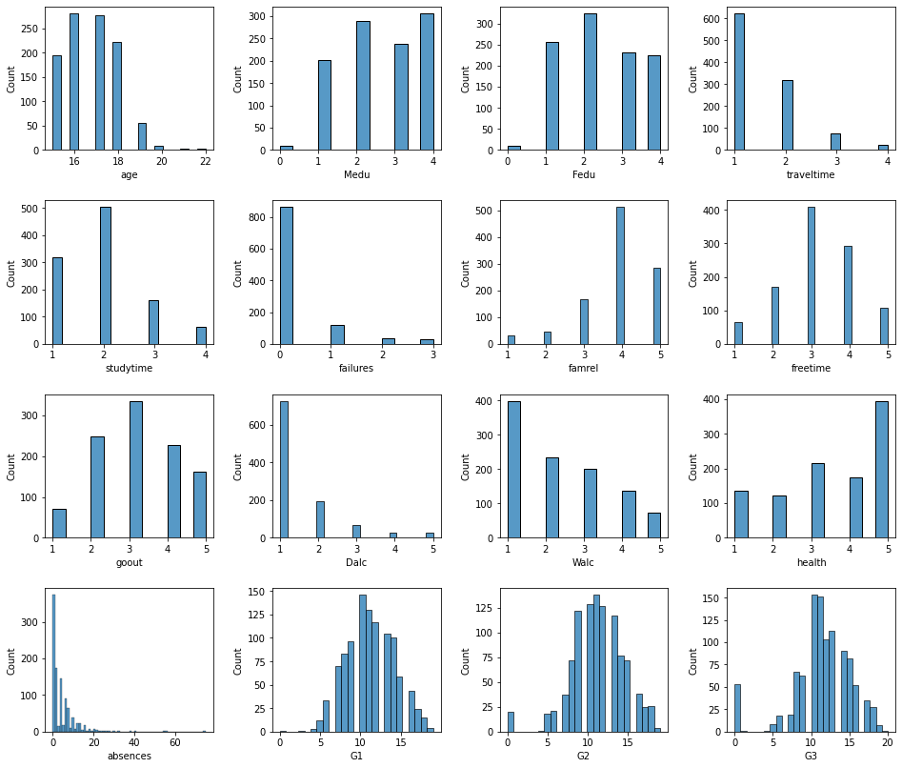
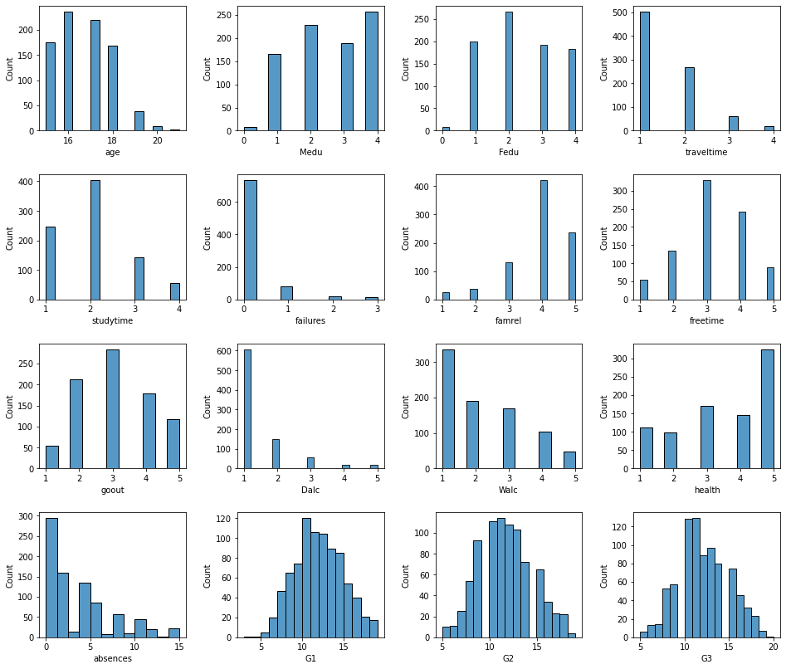
CLEANING AND PREPROCESSING

Slide 11
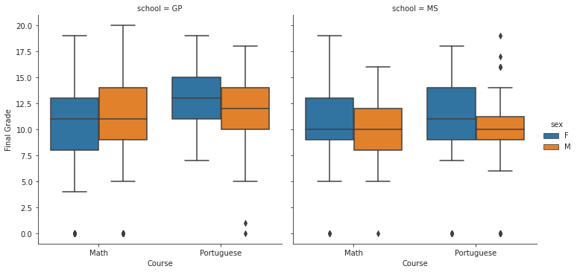
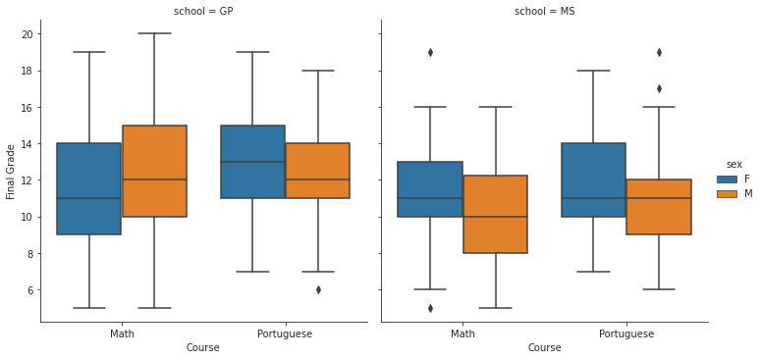
VISUALIZATION

Slide 12
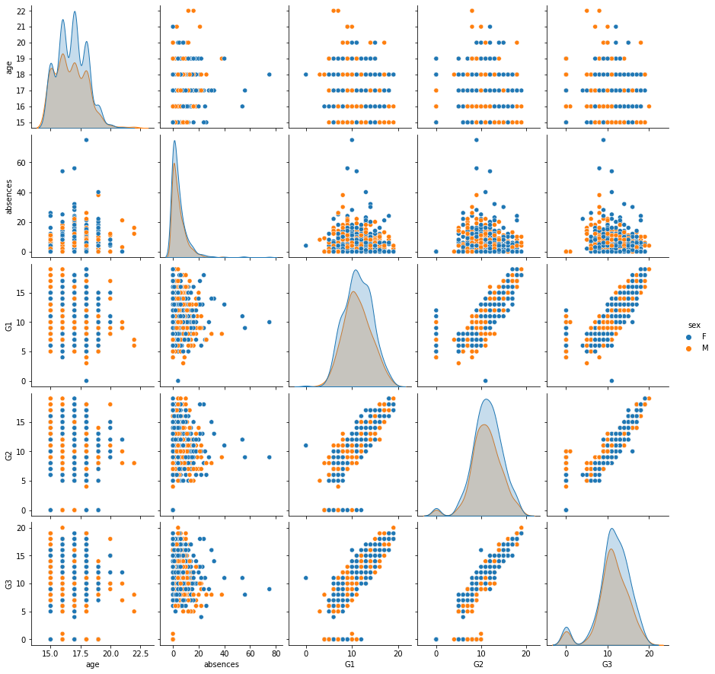
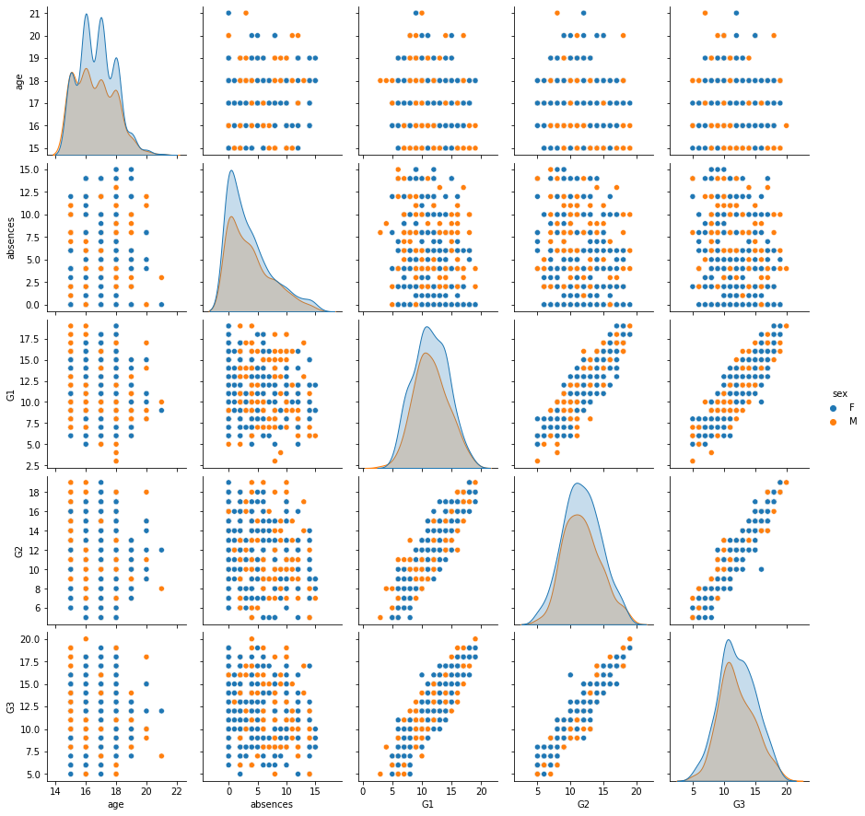
VISUALIZATION

Slide 13
HYPOTHESIS TESTING
3
Assumption Checks, Factorial Design, Test Conclusions

Slide 14
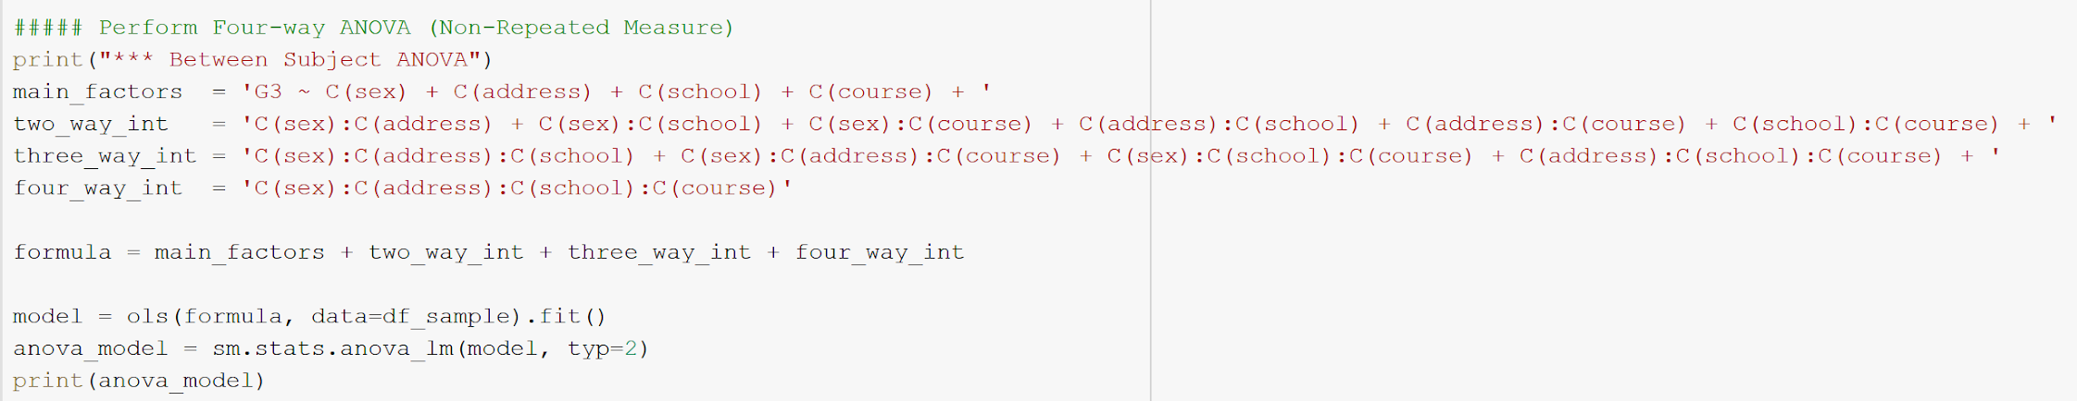
FACTORIAL DESIGN: FOUR WAY ANOVA
A factorial ANOVA was employed because the independent measures (sex, address, school, course, and their interactions) were categorical variables. Furthermore, Chi-Squared could not be used because we were regressing on a continuous variable (G3--final grade) which was our dependent variable.

Slide 15
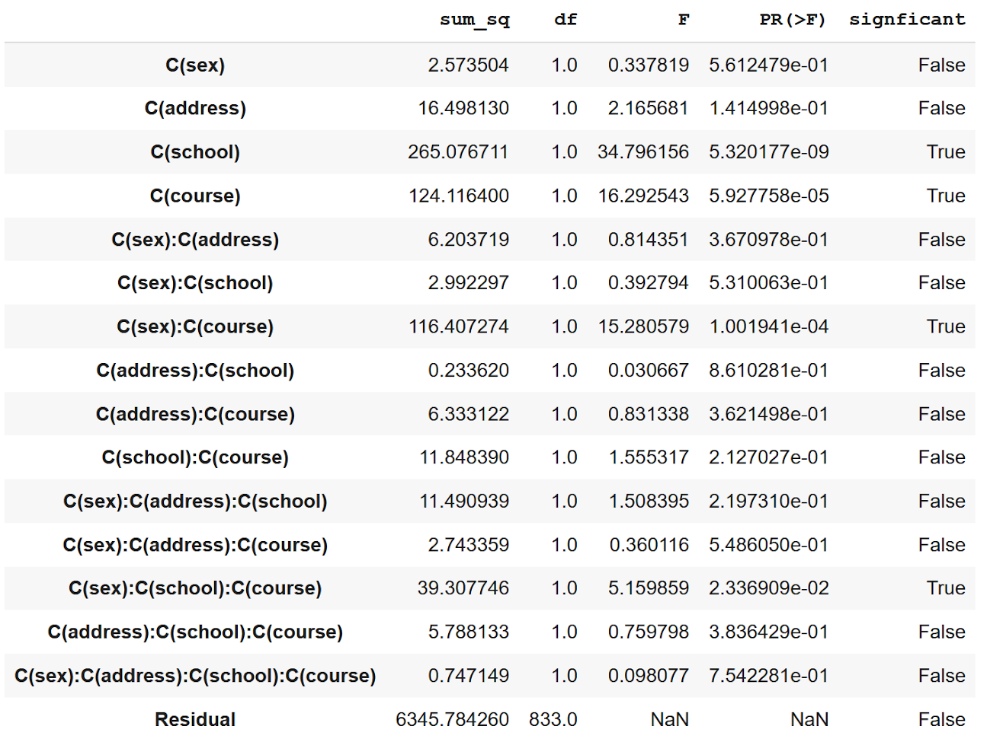
INITIAL RESULTS
At the five percent level of significance, the school and course variables were significant along with some of their interactions.
Address (distance to school) and sex were not significant.

Slide 16
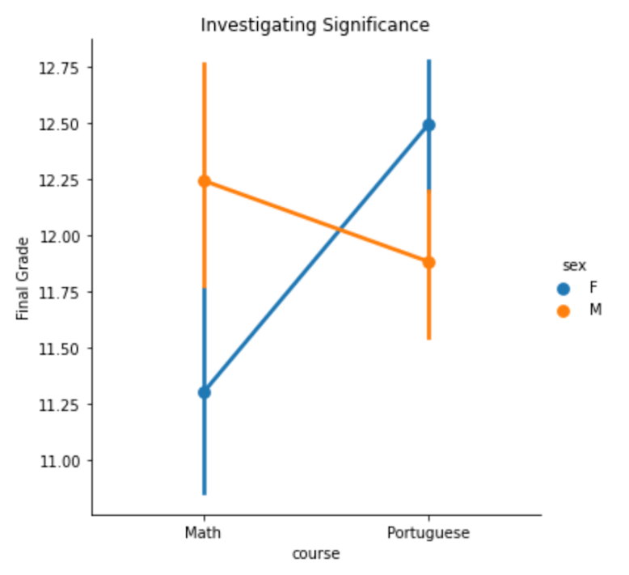
VISUALIZING SIGNIFICANT INTERACTIONS
Variable = “C(sex):C(course)”
P-value = 0.001
The two way interaction between gender and course indicates a statistically significant difference in final grades for different genders depending on the course (or vice versa).

Slide 17
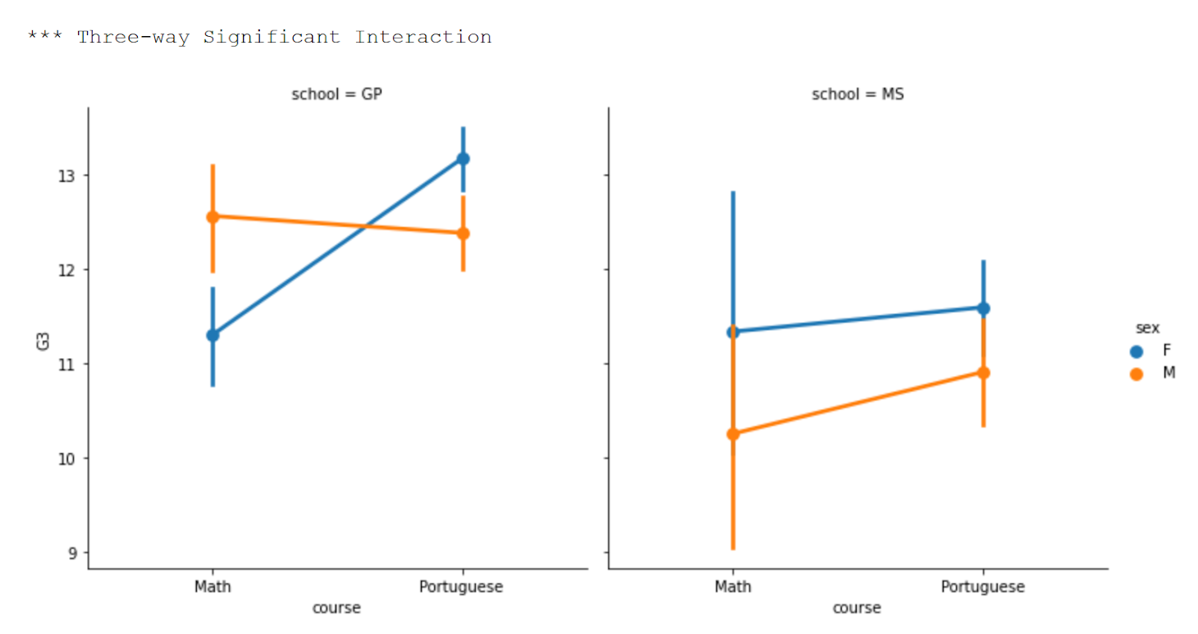
VISUALIZING SIGNIFICANT INTERACTIONS (CONT.)
Variable =
“C(sex):C(school):C(course)”
P-value = 0.023
At Mousinho da Silveira, the two-way gender effect does not carry. Rather, women outperform men in both math and language courses.
The disparate gender outcomes at Gabriel Pereira is strong enough to affect the entire dataset.

Slide 18
ASSUMPTION: 1) INDEPENDENT OBSERVATIONS
We assume that the performance of each students should not be affected by the performance of another student. Latent social factors could be influencing the school or address variables. For simplicity, four independent variables were chosen.
The strongest concern were the 382 students (pre-cleaning) who took both math and language courses. However, we assume that performance in math should not affect performance in language. Furthermore, we assume that their performance in those classes are likely due to the independent measures (sex, school, course, address) or other latent variables.

Slide 19
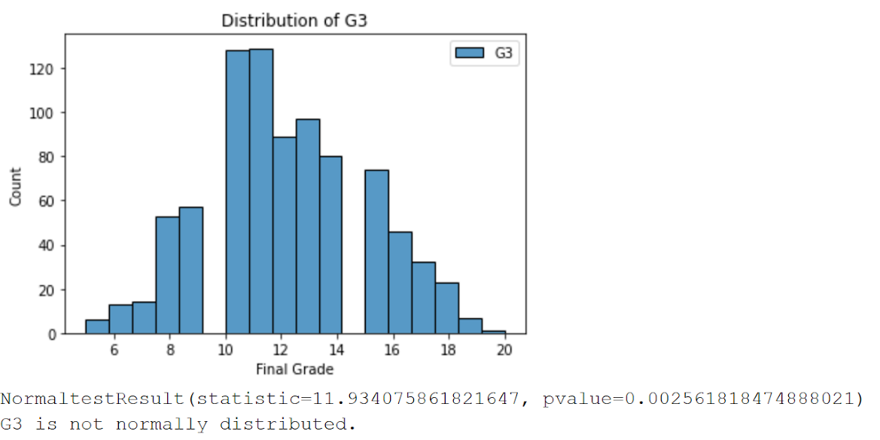
ASSUMPTION: 2) NORMALCY
The distributions of the dependent variable, G3 or final grade, was not normal.
However, it was close though statistically different when using a hypothesis test for computing a statistic of (skew^2 + kurtosis^2).
With the large sample size (849 observations), we believe this effect did not substantively interfere with our results.

Slide 20
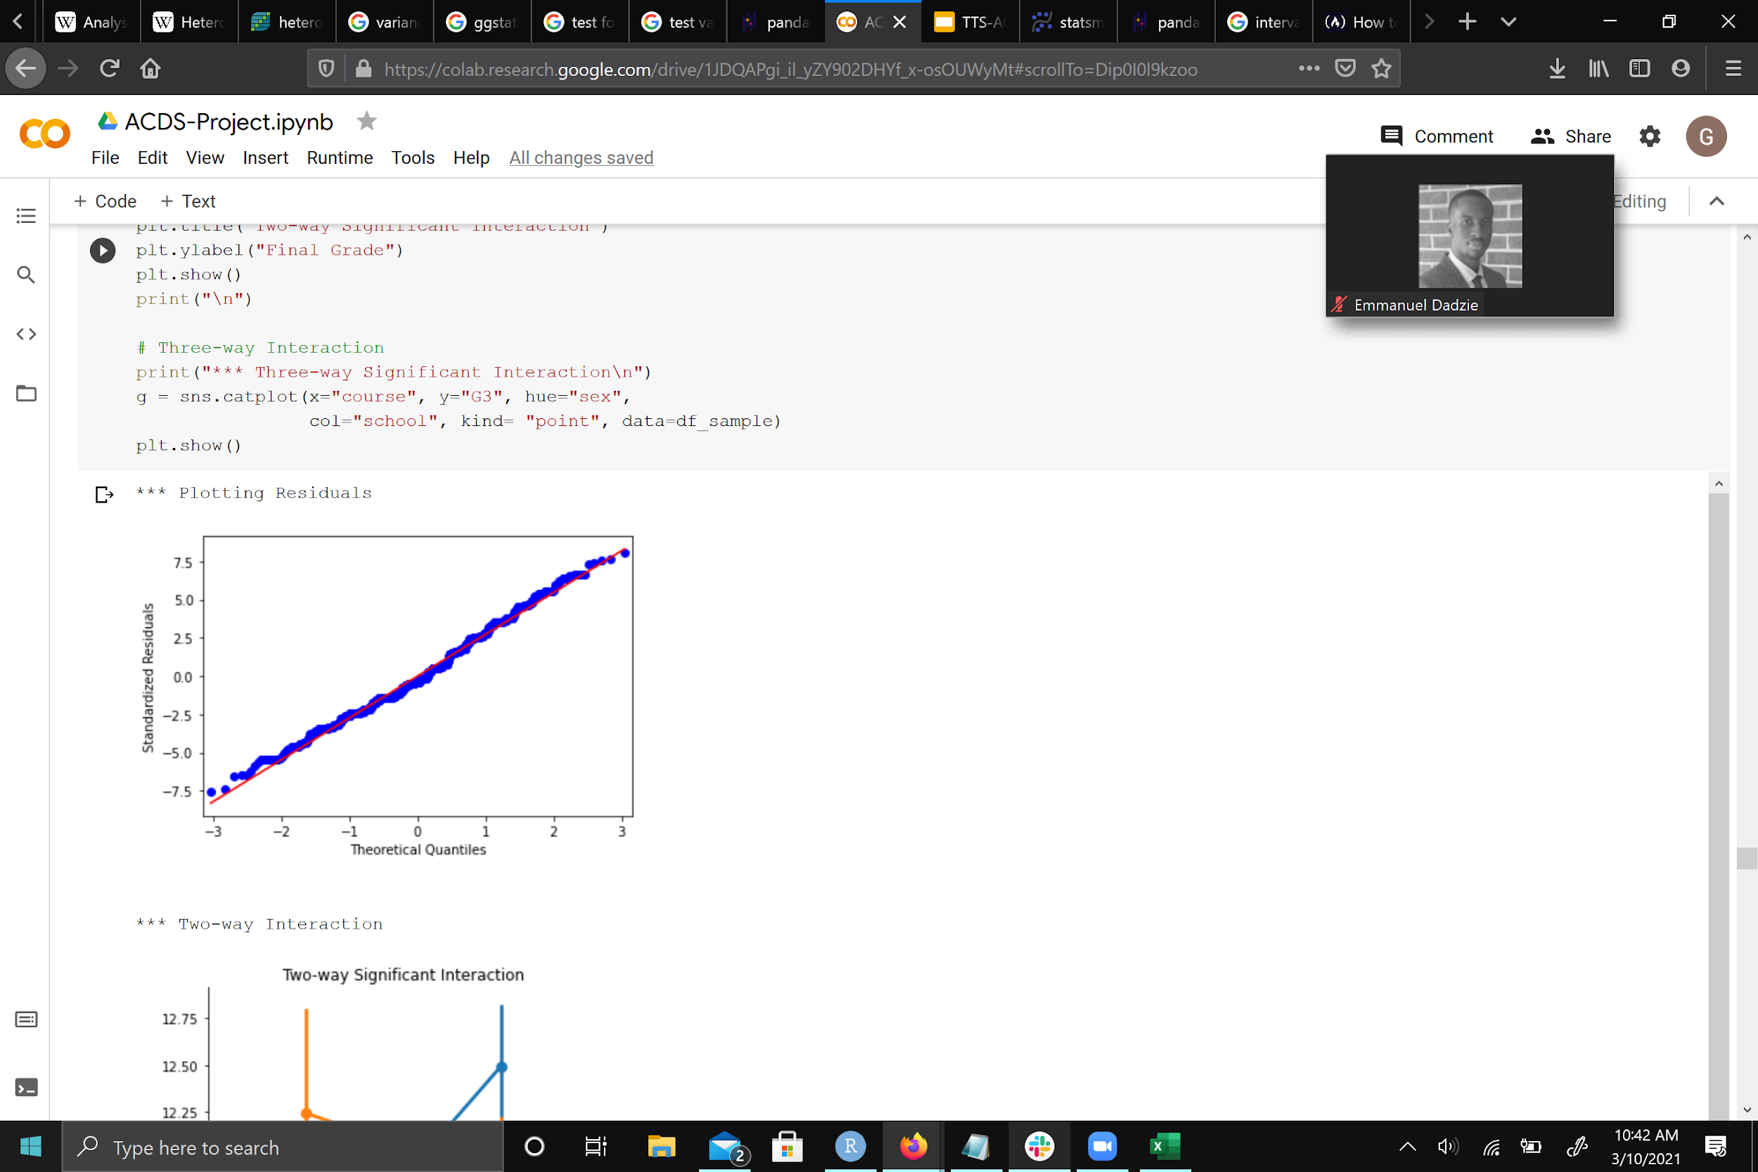
ASSUMPTION: 3) NORMALCY OF RESIDUALS
The distribution of the residuals should be normal--that is the error term should be homoskedastic (having the same variance across the distribution). Unfortunately, this is violated. Thankfully, this is an easy fix.

Slide 21
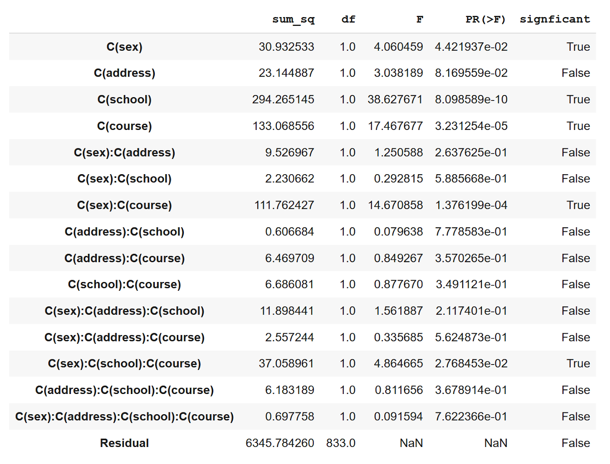
TESTING CONCLUSIONS
With a Robust Standard Error correction, we fix our homoscedasticity violation.
With the correction, sex is now a statistically significant variable. However, none of the interaction variables changed in significance.
Interestingly, distance to the school (address) is still not significant in determining final grade outcomes.
Further studies of the collected social measures thus need not include address as a variable.

Slide 22
ML PREDICTIVE MODELING
4
Encoding Categorical Values, Feature Selection, Extraction & Union, Pipeline, Multi-output Model

Slide 23
ENCODING CATEGORICAL DATA
The data had 18 categorical variables with string data type
The encoding technique used was one-hot
Encoding these variables resulted in 45 columns
The new fully encoded data resulted in 61 columns

Slide 24
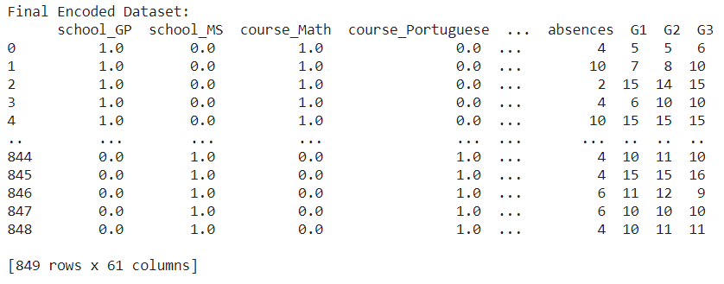
ENCODING CATEGORICAL DATA
Below is code & the resulting table
# Separating the data into numeric and categorical data
df_student_cat = df_student_clean.select_dtypes(include=[object])
df_student_num = df_student_clean.select_dtypes(include=[int])
# creating column names for OneHot Encoder
cat_col_names = []
for k, v in col_unique_vals.items():
cat_col_names.extend([f"{k}_{val}" for val in v])
### One Hot Encoder
enc = preprocessing.OneHotEncoder()
enc.fit(df_student_cat)
onehotlabels = enc.transform(df_student_cat).toarray()
# Create Dataframe
df_onhot_cat = pd.DataFrame(onehotlabels, columns=cat_col_names)
# Integrate Datasets
df_student_enc = pd.merge(df_onhot_cat, df_student_num, how="inner", on=[df_onhot_cat.index])
df_student_enc.drop(columns=["key_0"], inplace=True)

Slide 25
FEATURE SELECTION AND EXTRACTION
Techniques used PCA, IDA, UFS
# PCA-Transformed Data
df_pca = feature_engineering(df_student_enc, n_features= 20, transform='PCA', score_fn=f_regression, details='no')
# ICA-Transformed Data
df_ica = feature_engineering(df_student_enc, n_features= 9, transform='ICA', score_fn=f_regression, details='no')
# UFS Data
df_ufs = feature_engineering(df_student_enc, n_features= 6, transform='UFS', score_fn=f_regression, details='no')
ICA Data:
Component_1 Component_2 ... Component_9 D_Variable
0 0.016876 0.017656 ... -0.022149 6.0
1 0.004380 0.049214 ... 0.034507 10.0
2 -0.034249 -0.045815 ... -0.046143 15.0
3 -0.037654 0.009746 ... 0.046791 10.0
4 -0.045848 0.045706 ... 0.021414 15.0
.. ... ... ... ... ...
844 -0.024853 -0.015720 ... 0.008041 10.0
845 0.064450 -0.015103 ... 0.018679 16.0
846 -0.015520 -0.078823 ... 0.013697 9.0
847 0.037454 0.011481 ... 0.015913 10.0
848 -0.025681 0.004423 ... 0.026730 11.0
[849 rows x 10 columns]
PCA Data:
Component_1 Component_2 ... Component_20 D_Variable
0 7.546786 -5.484705 ... -0.180323 6.0
1 8.644846 1.306257 ... -0.812115 10.0
2 -4.468663 1.406632 ... -0.160714 15.0
3 4.096804 -2.762625 ... 0.055869 10.0
4 -0.088878 8.150904 ... 0.512379 15.0
.. ... ... ... ... ...
844 1.538688 -0.679121 ... -1.061850 10.0
845 -3.539369 3.223805 ... -0.605727 16.0
846 1.692863 1.565653 ... -0.085670 9.0
847 3.632132 0.550594 ... -1.258724 10.0
848 1.755790 -0.734443 ... -0.746325 11.0
[849 rows x 21 columns]
UFS Data:
G2 G1 failures higher_yes higher_no Medu D_Variable
0 0.0 1.0 1.0 0.0 5.0 5.0 6.0
1 0.0 1.0 1.0 3.0 7.0 8.0 10.0
2 0.0 1.0 4.0 0.0 15.0 14.0 15.0
3 0.0 1.0 3.0 0.0 6.0 10.0 10.0
4 0.0 1.0 4.0 0.0 15.0 15.0 15.0
.. ... ... ... ... ... ... ...
844 0.0 1.0 2.0 1.0 10.0 11.0 10.0
845 0.0 1.0 3.0 0.0 15.0 15.0 16.0
846 0.0 1.0 1.0 0.0 11.0 12.0 9.0
847 0.0 1.0 3.0 0.0 10.0 10.0 10.0
848 0.0 1.0 3.0 0.0 10.0 11.0 11.0
[849 rows x 7 columns]

Slide 26
MACHINE LEARNING ALGORITHMS
Algorithms used are:
K-Nearest Neighbor
Naive Bayes
Support Vector Machines
Gradient Boosting
Adaboost
Random Forest
Linear Regression
Regression models were created using each algorithm based on the various preprocessed datasets

Slide 27
MODEL RESULTS - TABLES
Results - Raw Data:
Algorithm Mean STD
0 KNN 0.847110 0.043468
1 NB 0.899881 0.048103
2 SVM 0.896920 0.044957
3 GB 0.894162 0.038298
4 AB 0.879583 0.044148
5 RF 0.890645 0.039314
6 LR 0.898605 0.047963
Results - PCA Data:
Algorithm Mean STD
0 KNN 0.848989 0.043360
1 NB 0.899766 0.051211
2 SVM 0.875276 0.041498
3 GB 0.839894 0.051668
4 AB 0.829749 0.054216
5 RF 0.859047 0.058251
6 LR 0.899506 0.051568
Results - UFS:
Algorithm Mean STD
0 KNN 0.874271 0.049013
1 NB 0.901496 0.040069
2 SVM 0.898242 0.039061
3 GB 0.893891 0.036257
4 AB 0.875822 0.038196
5 RF 0.877920 0.041695
6 LR 0.901470 0.040070
Results - ICA:
Algorithm Mean STD
0 KNN 0.704676 0.038457
1 NB 0.897557 0.046100
2 SVM 0.826053 0.040852
3 GB 0.747143 0.061399
4 AB 0.768995 0.064293
5 RF 0.806332 0.065333
6 LR 0.897544 0.046152

Slide 28
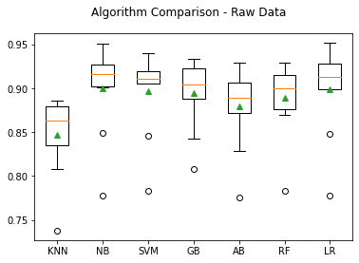
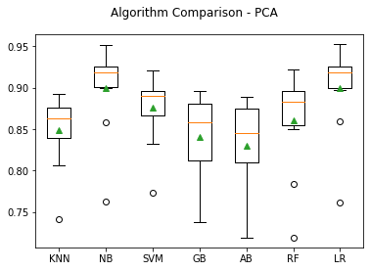
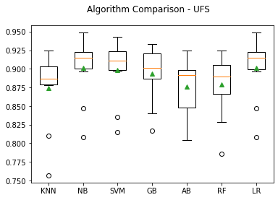
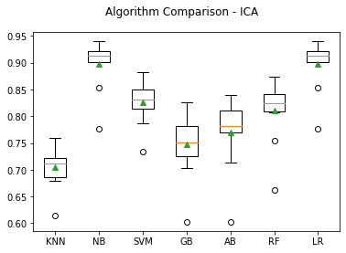
MODEL REPORT - GRAPHS

Slide 29
FINAL CONCLUSIONS
5
Summary, Takeaways, Recommendations, and Future Work

Slide 30
SUMMARY
Our project performed exploratory and inferential analysis on the student performance datasets
The results indicate gender, school, and course significantly affects final grades
Also, there were other two-way and three-way interactions between among these factors as well that influenced the final grades
Finally, a predictive model created using machine learning and feature extraction/selection techniques yielded significant performance in estimating the grade based on other factors

Slide 31
RECOMMENDATIONS & FUTURE WORK
Future work must consider exploring more ML algorithm models, feature engineering, and ensemble techniques to further enhance performance
The algorithms with hyper-parameters must be tuned to achieve the maximum performance
There should be a holistic optimization that takes into account algorithm tuning and feature unions to derive the most optimal performance
The predictive model should be automated using pipeline modules
Coefficient analysis with recoded data could inform policy makers with decisions regarding social and educational investments/interventions

Slide 32
THANK YOU
Questions?

